Slide 1


CREATING AWARENESS ABOUT COVID-19

Slide 2
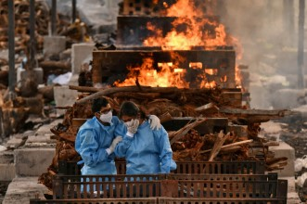
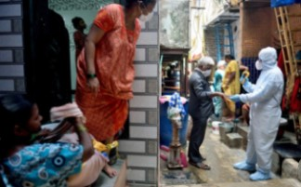

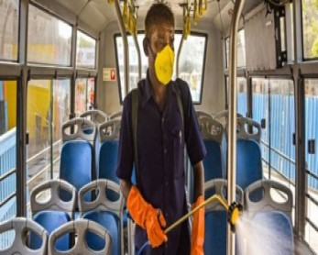
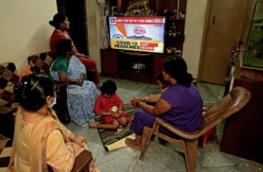
Here is a responsive website that describes how corona effected our lives, precautions, symptoms,
vaccination, and to help
Poor, lets contribute as much as we can!!!

Slide 3
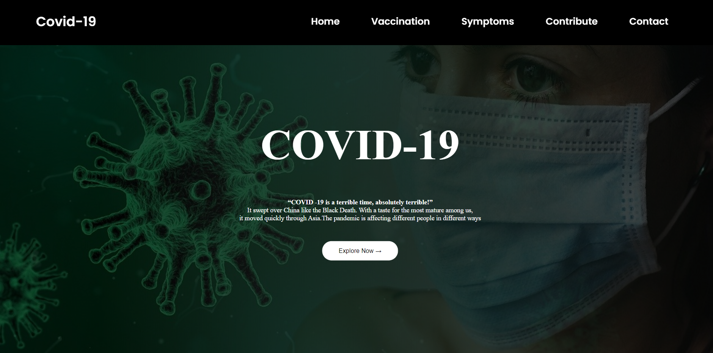
THIS IS THE HOME PAGE WHICH GUIDES YOU TO EXPLORE THE WEBSITE,
And yes !!! “COVID-19 IS A TERRIBLE TIME ABSOLUTELY TERRIBLE “ IT SWEPT OVER CHINA LIKE BLACK DEATH AND NOW ASIA IT HAS EFFECTED PEOPLE IN DIFFERENT WAYS

Slide 4
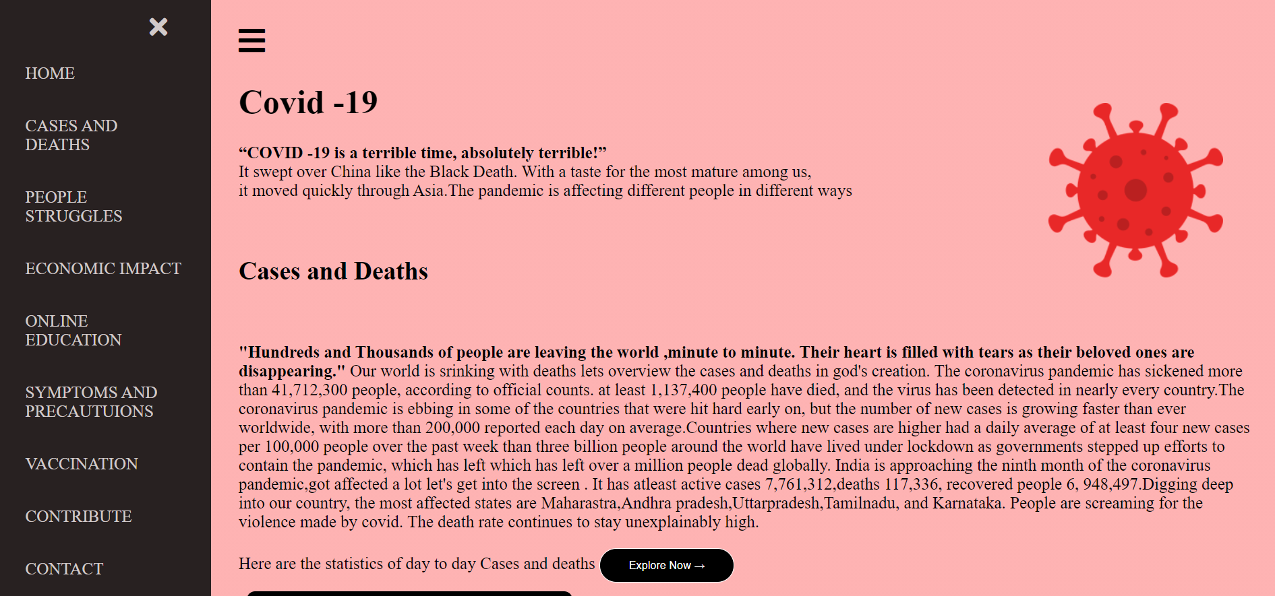
NOW LET’S EXPLORE HOW PEOPLE ARE STRUGGLING IN THIS PANDEMIC

Slide 5
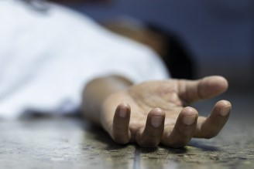
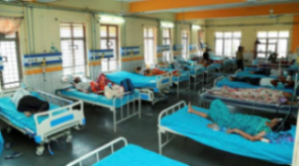
"Hundreds and Thousands of people are leaving the world ,minute to minute. Their heart is filled with tears as their beloved ones are disappearing."
DEATHS
Countries where new cases are higher had a daily average of at least four new cases per 100,000 people over the past week than three billion people around the world have lived under lockdown as governments stepped up efforts to contain the pandemic, which has left which has left over a million people dead globally.
We, have provided the statistics page of Covid-19 !!!
CASES

Slide 6
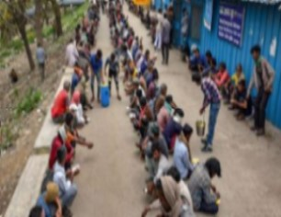
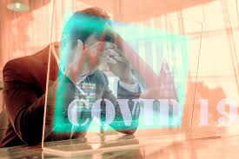
From two nationally representative surveys that were initiated to provide up-to-date estimates of the consequences of the COVID-19 pandemic, including the incidence of food insecurity. Food insecurity occurs when a household has difficulty providing enough food due to a lack of resources.
The Indian economy was expected to lose over ₹32,000 crore every day during the first 21-days of complete lockdown, which was declared following the coronavirus outbreak. Under complete lockdown, less than a quarter of India's $2.8 trillion economic movement was functional. India faces a huge decline in government revenues and growth of the income for at least two quarters as the coronavirus hits economic activity of the country as a whole.
FOOD INSECURITY
ECONOMIC IMPACT

Slide 7
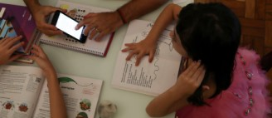
Many poor people are unable to afford data plans for their study through online so they have quit studying at this terrible time .so governments should take action providing them a free data plan atleast 1GB and providing them minimal cost smart phones. Conducting offline mode is not a good idea as it effects their health and they cant afford doctor's fee so it is necessary to take the required steps by government.
ONLINE EDUCATION

Slide 8
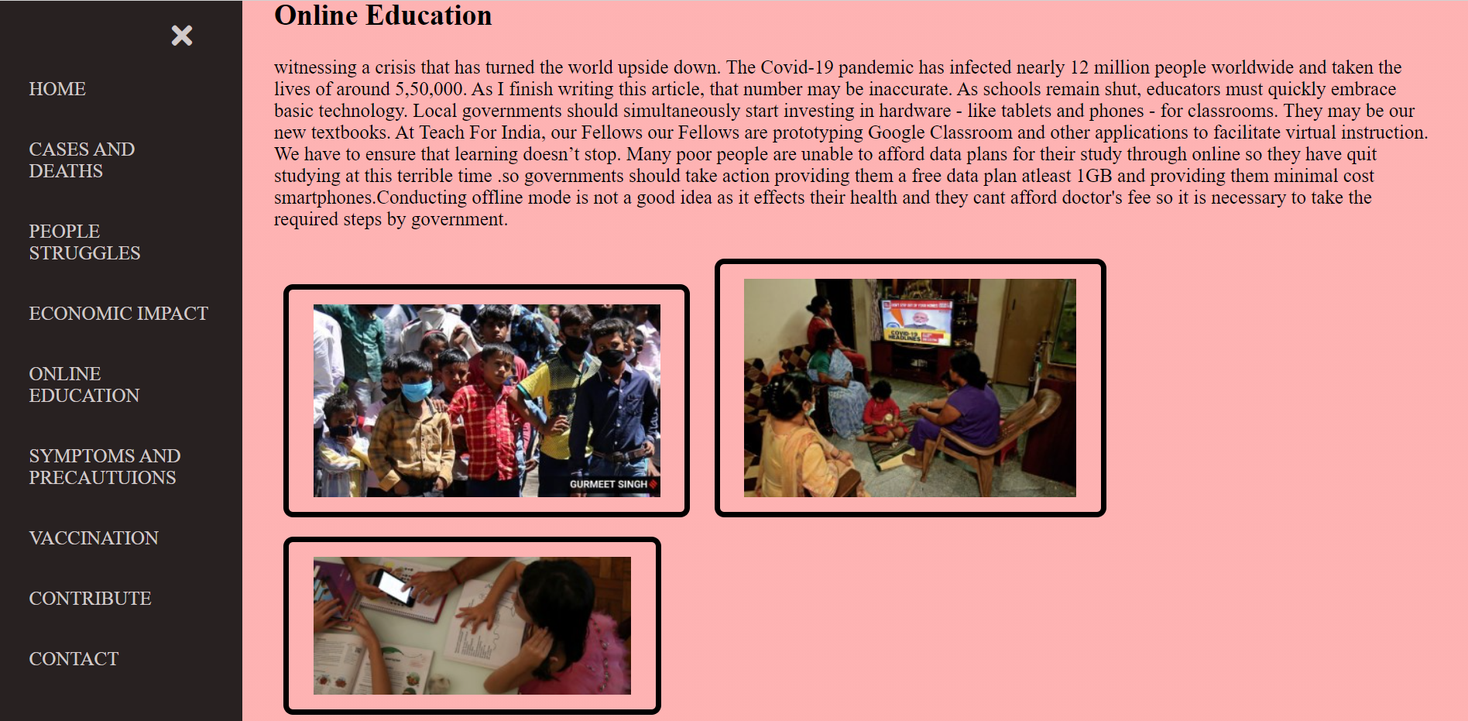
THIS IS THE END OF THIS PAGE !!!

Slide 9
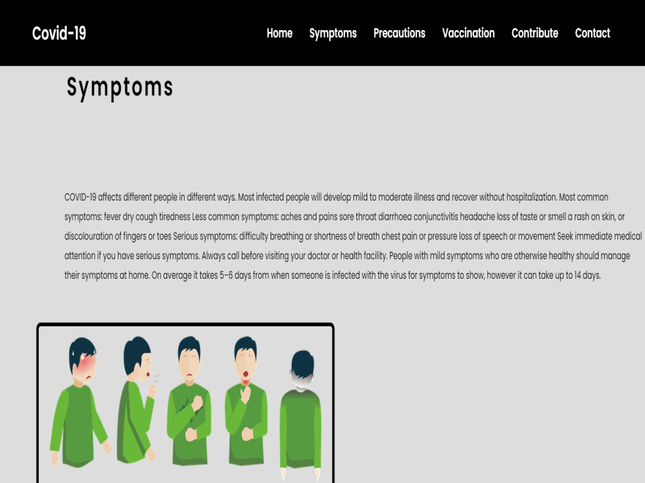
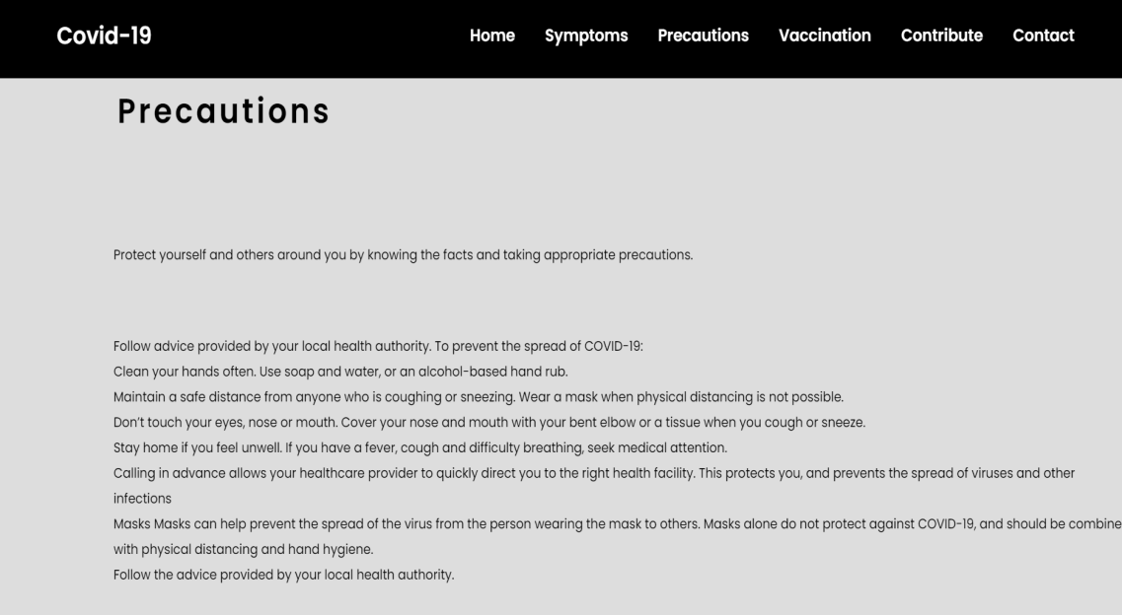
SYMPTOMS AND
PRECAUTIONS

Slide 10

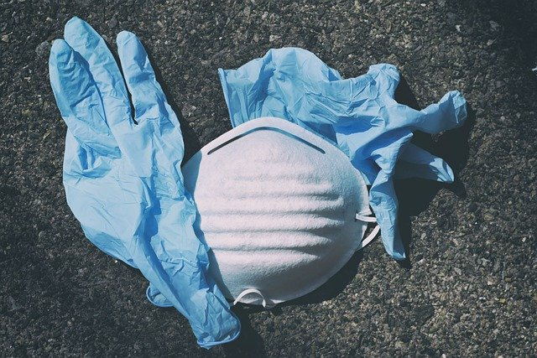
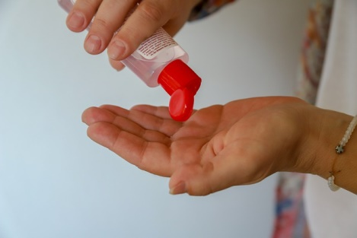


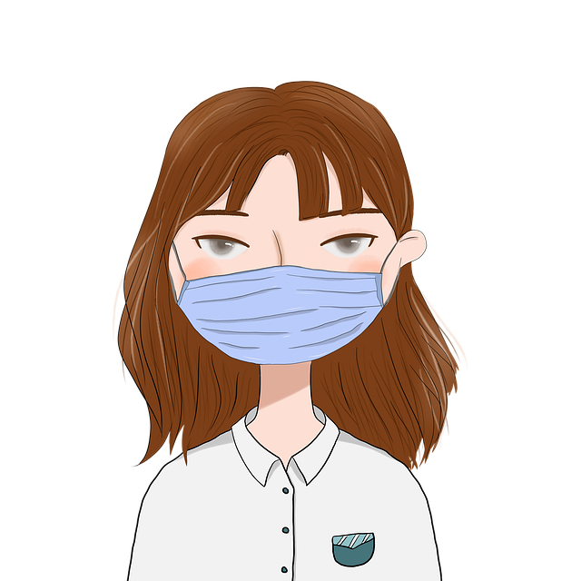

Slide 11
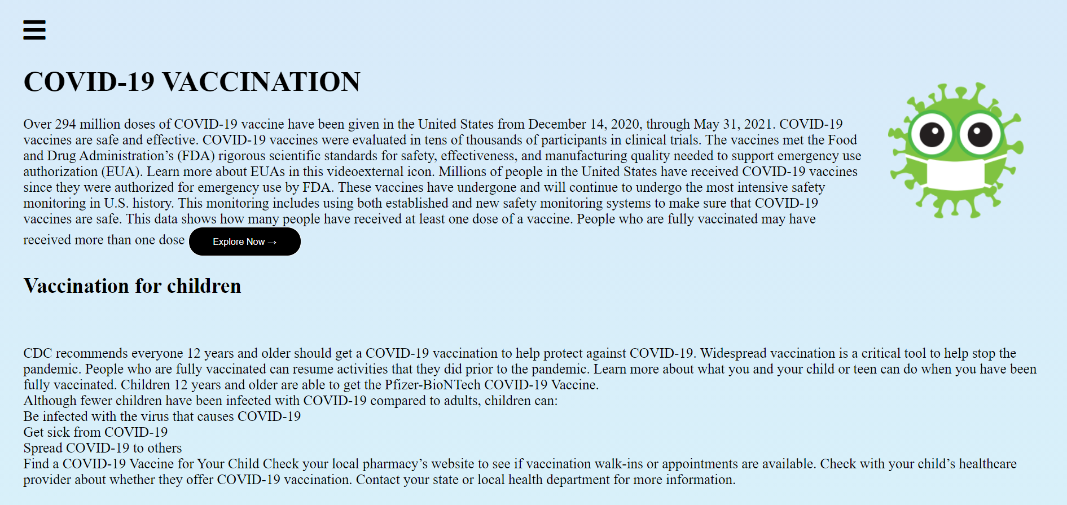
VACCINATION

Slide 12
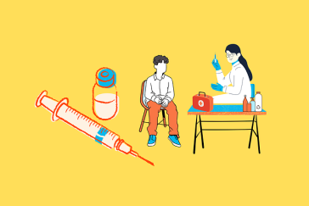

TOPICS THAT COVER ABOUT VACCINATION:
TYPES OF VACCINE:
Covidshield, Covaxin being administered, Sputnik V
2. VACCINE FOR CHILDREN:
CDC recommends everyone 12 years and older should get a COVID-19 vaccination to help protect against COVID-19. Widespread vaccination is a critical tool to help stop the pandemic.
Children 12 years and older are able to get the Pfizer-BioNTech COVID-19 Vaccine.

Slide 13
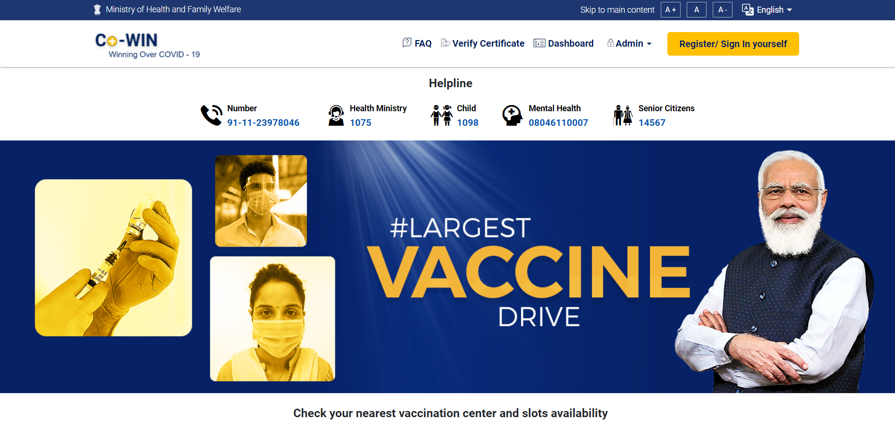
3.REGISTRATION FOR VACCINE:
Link to register: https://www.cowin.gov.in/home

Slide 14
LET’S CONTRIBUTE
FOR THE POOR
IN THIS HARD TIME’S

Slide 15
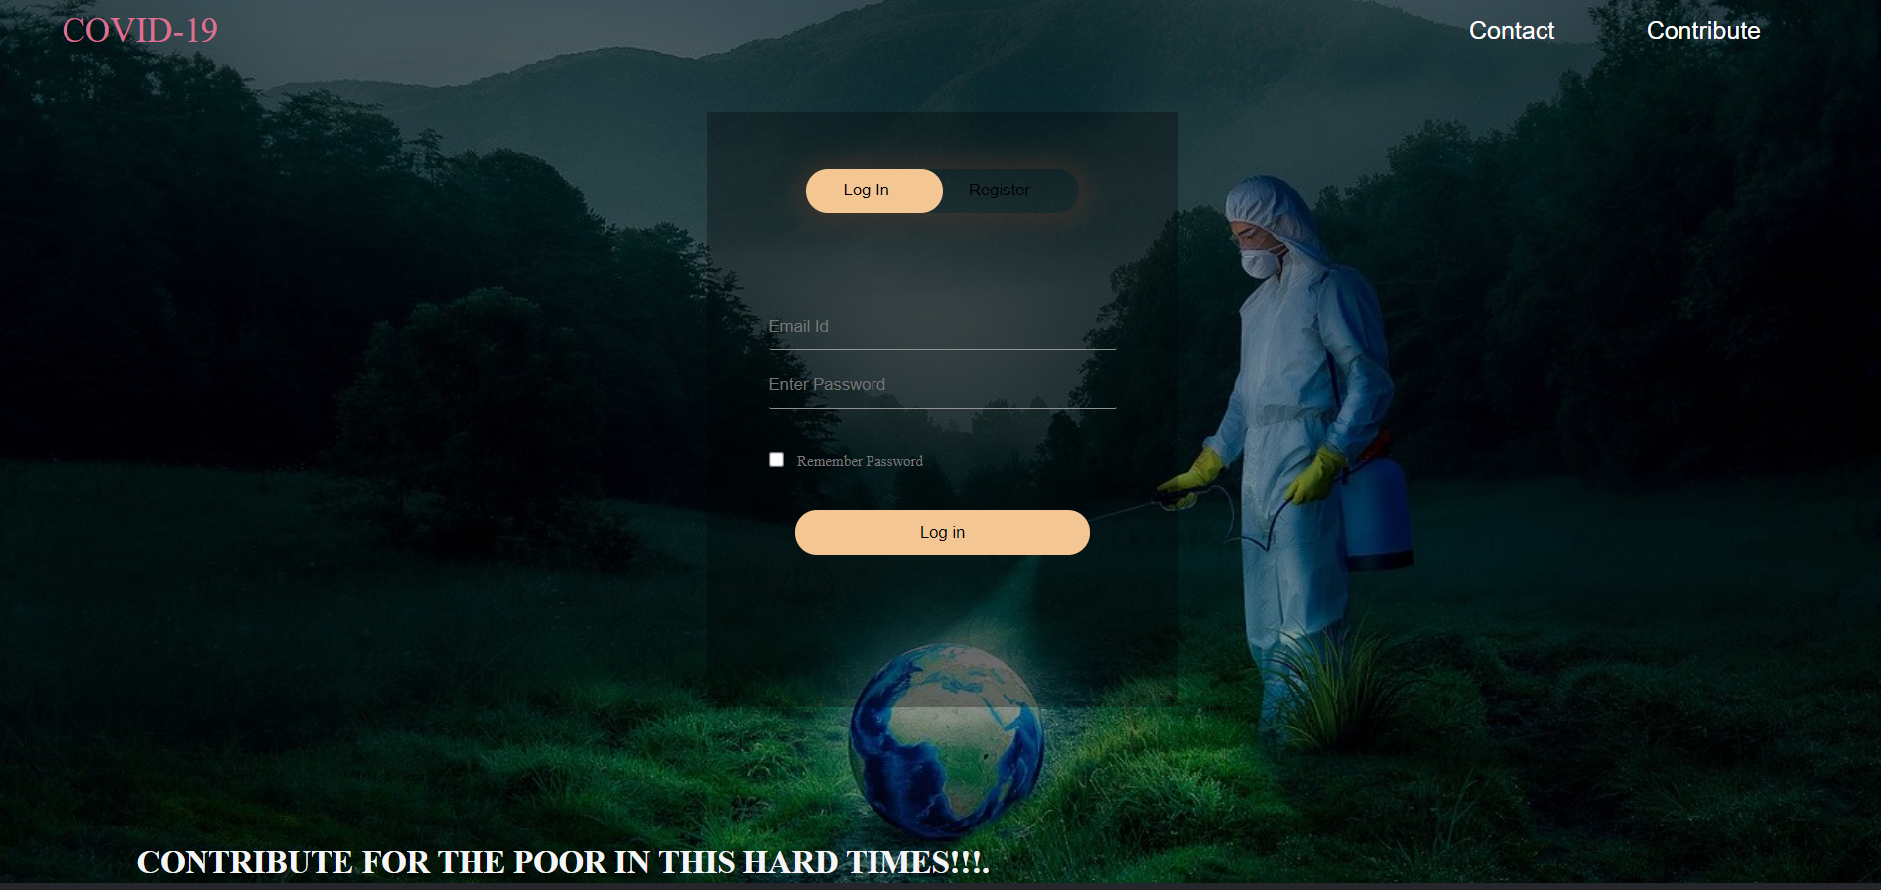

Slide 16
THANK YOU
EXPOSYS DATALABS
FOR GIVING US A WONDERFUL
OPPORTUNITY!!!

